Slide 1
CHAPTER NO: 02 DISCRETE-TIME SIGNALS

Slide 2
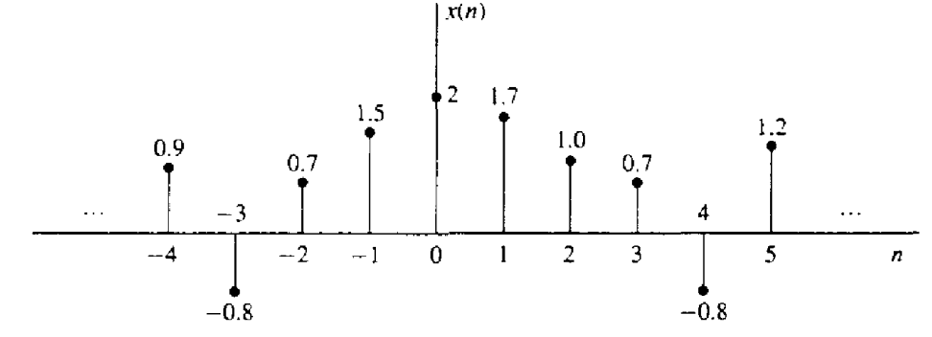
DISCRETE-TIME SIGNALS
A discrete time signal x(n) is a function of an independent variable that is an integer.
It is graphically represented as shown in Figure Below.
Figure: Graphical representation of a discrete-time signal.

Slide 3
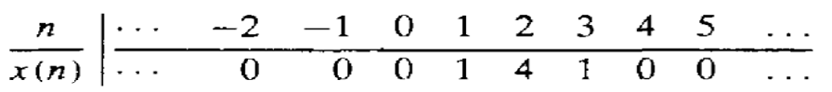
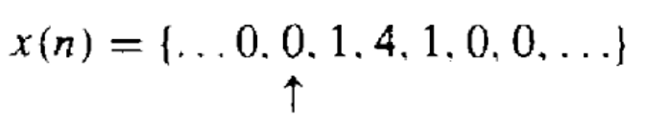
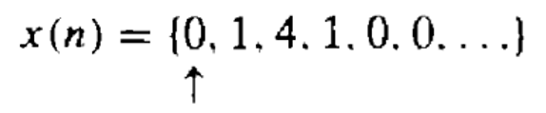
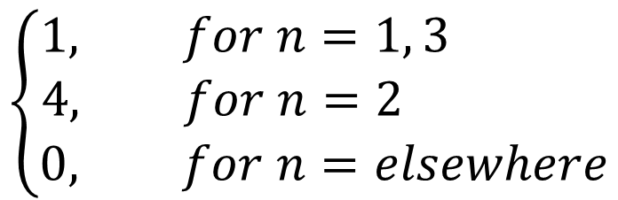
Alternative Ways/Methods TO Represent Discrete Time Signals
Method:1: Functional Representation of Discrete Time Signals
$$\left\{\begin{aligned}1, for n=1, 3 \\ 4, for n=2 \\ 0, for n=elsewhere\end{aligned}\right.$$
Method:2: Tabular Representation of Discrete Time Signals
Method:3: Sequence Representation of Discrete Time Signals
An infinite-duration signal or sequence with the time origin (n=0) indicated by the symbol ↑ is represented as
A sequence x(n), which is zero for n<0, can be represented as

Slide 4
Some Elementary Discrete-Time Signals
Unit Sample Sequence
Unit Ramp Signal
Exponential Signal
Unit Step
Signal

Slide 5
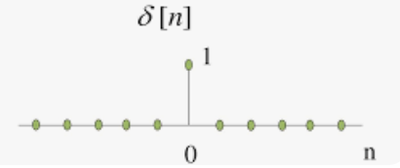
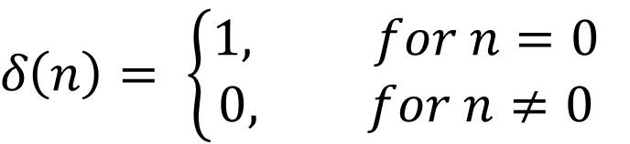
Unit Sample Sequence
A unit sample sequence, also known as an impulse sequence or delta sequence, is a discrete sequence that consists of a single sample with the value of 1 at a specific index, and all other samples are zero.
It is commonly represented as a discrete-time impulse function or unit impulse or delta function.
$δ\left(n\right)= \left\{\begin{aligned}1, for n=0 \\ 0, for n≠0\end{aligned}\right.$
Figure: Graphical representation of the Unit Sample Signal

Slide 6
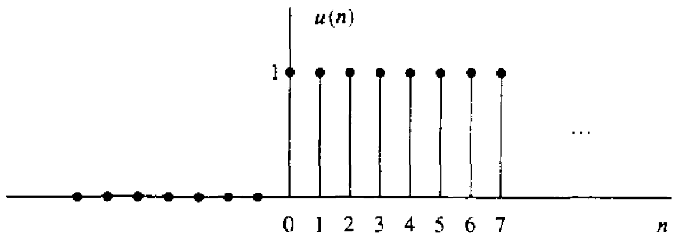
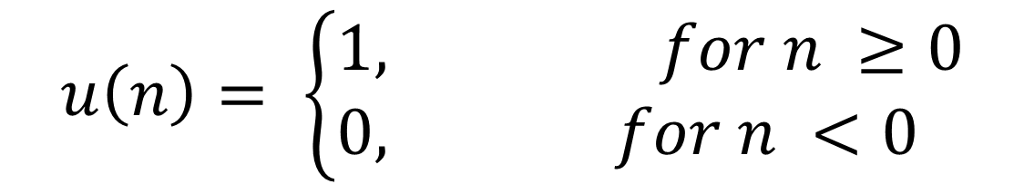
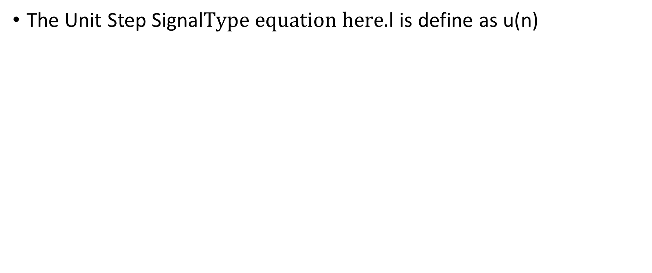
Unit Step Signal
The Unit Step Signall is define as u(n)
$$u\left(n\right)= \left\{\begin{aligned}1, for n ≥0 \\ 0, for n <0 \end{aligned}\right.$$
Figure: Graphical representation of the Unit Step Signal

Slide 7
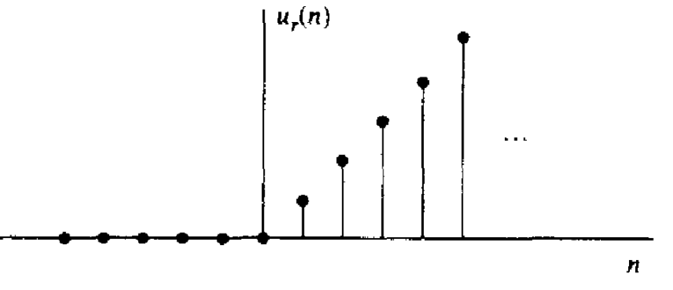
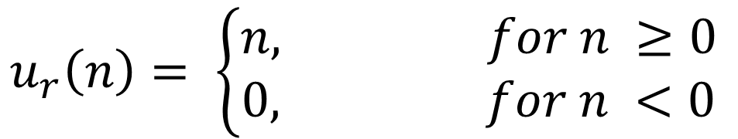
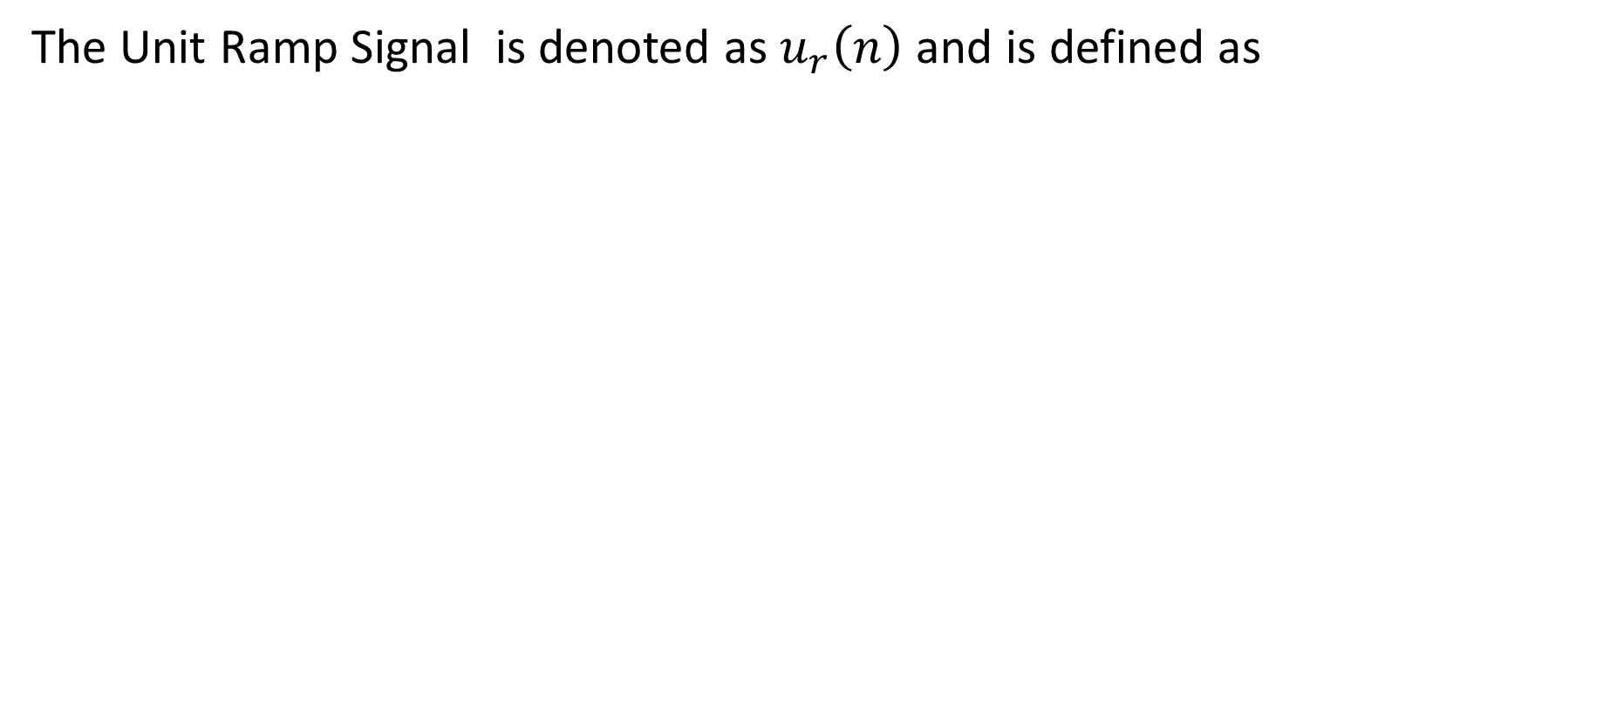
Unit Ramp Signal
The Unit Ramp Signal is denoted as $u_{r}\left(n\right)$ and is defined as
$$u_{r}\left(n\right)= \left\{\begin{aligned}n, for n ≥0 \\ 0, for n <0\end{aligned}\right.$$
Figure: Graphical representation of the Unit Ramp Signal

Slide 8
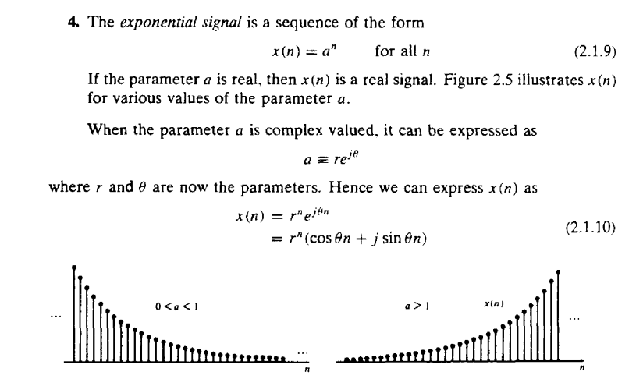

Slide 9
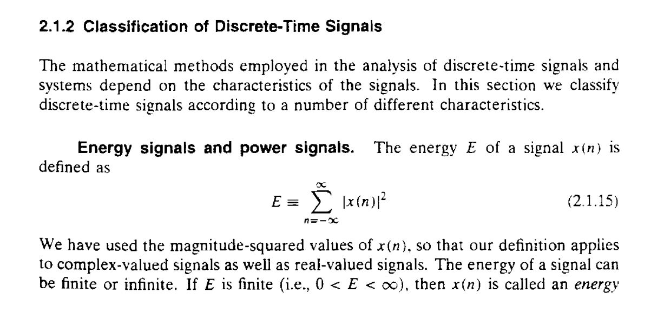

Slide 10
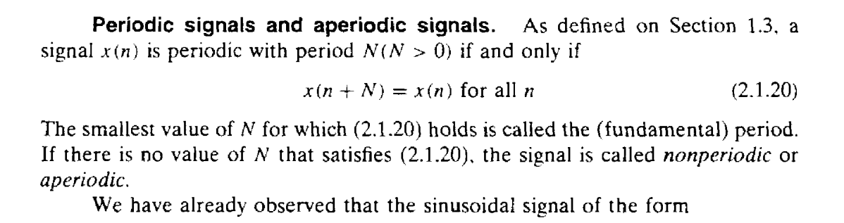

Slide 11
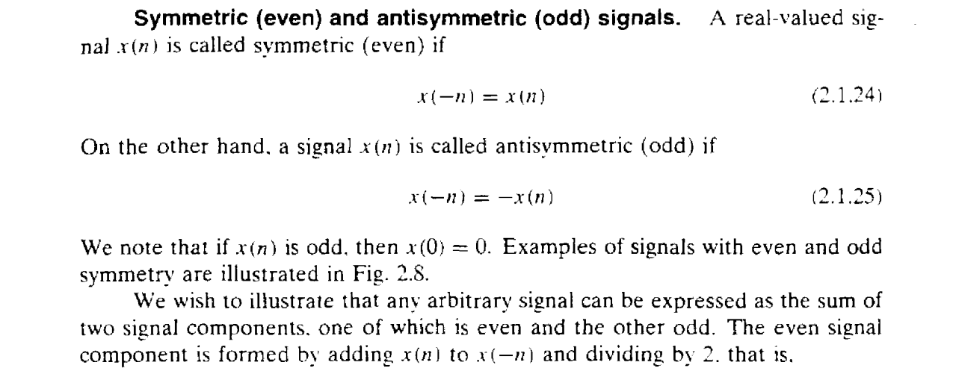

Slide 12
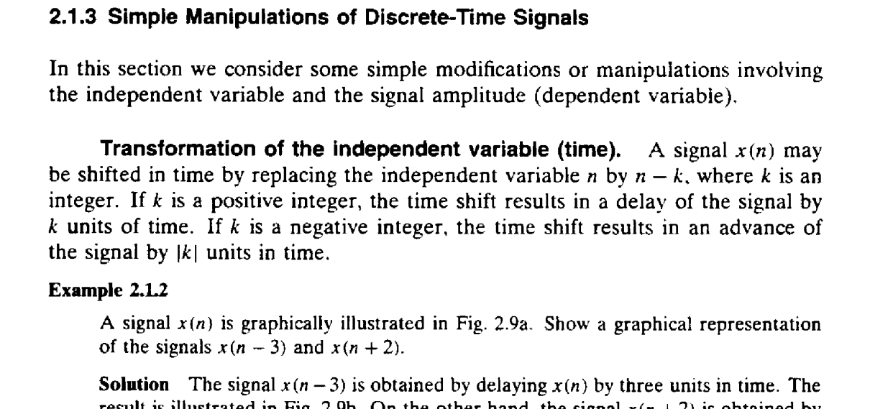

Slide 13
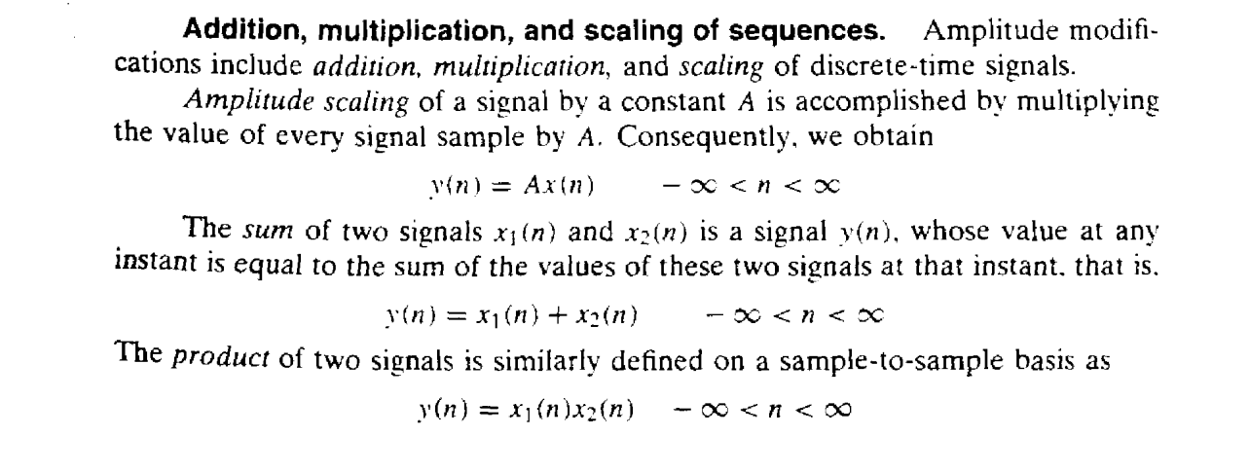

Slide 14
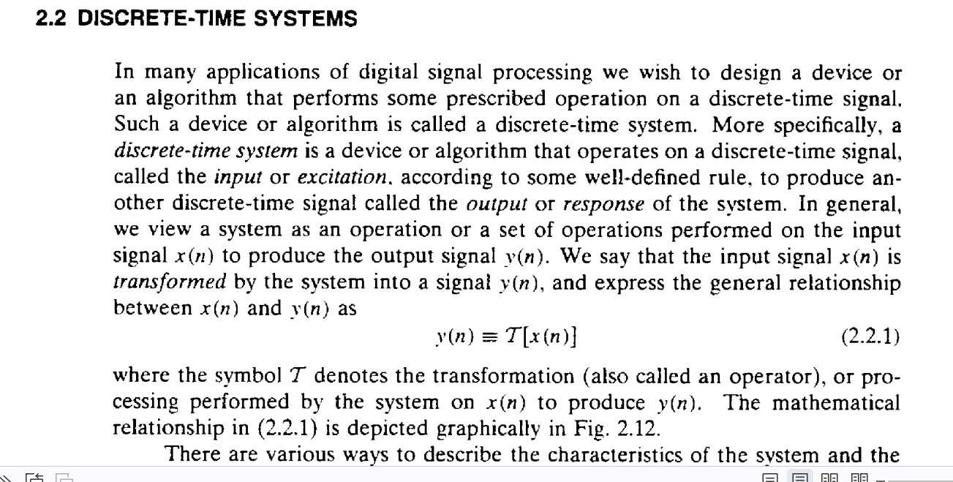

Slide 15
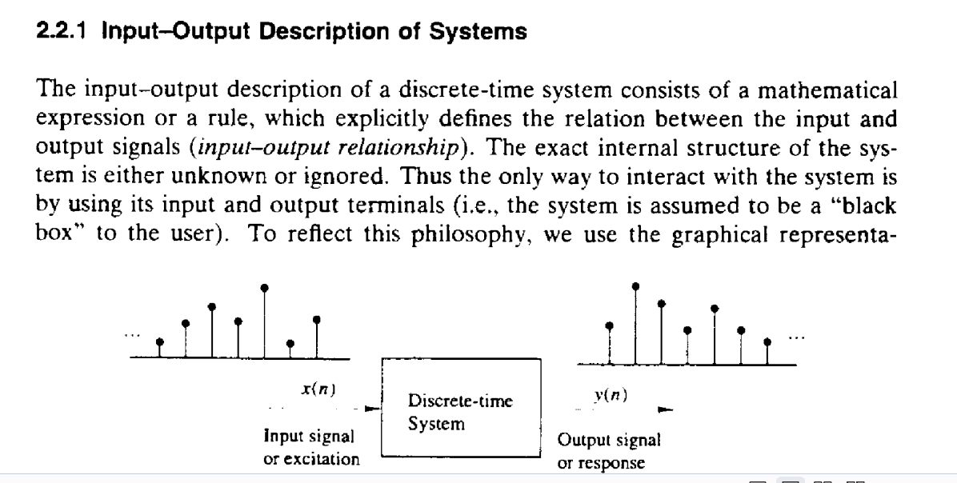

Slide 16
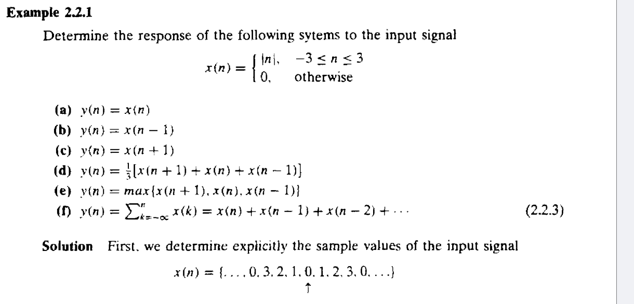

Slide 17
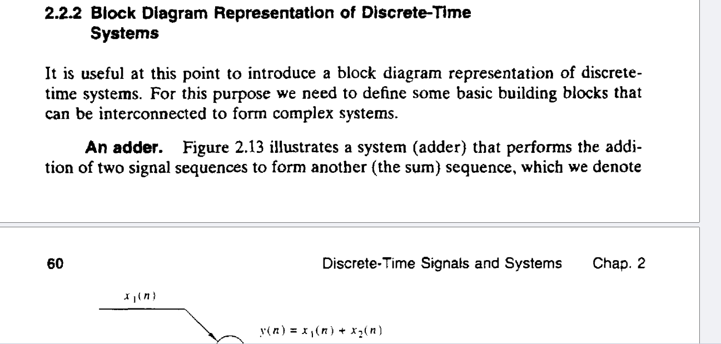

Slide 18
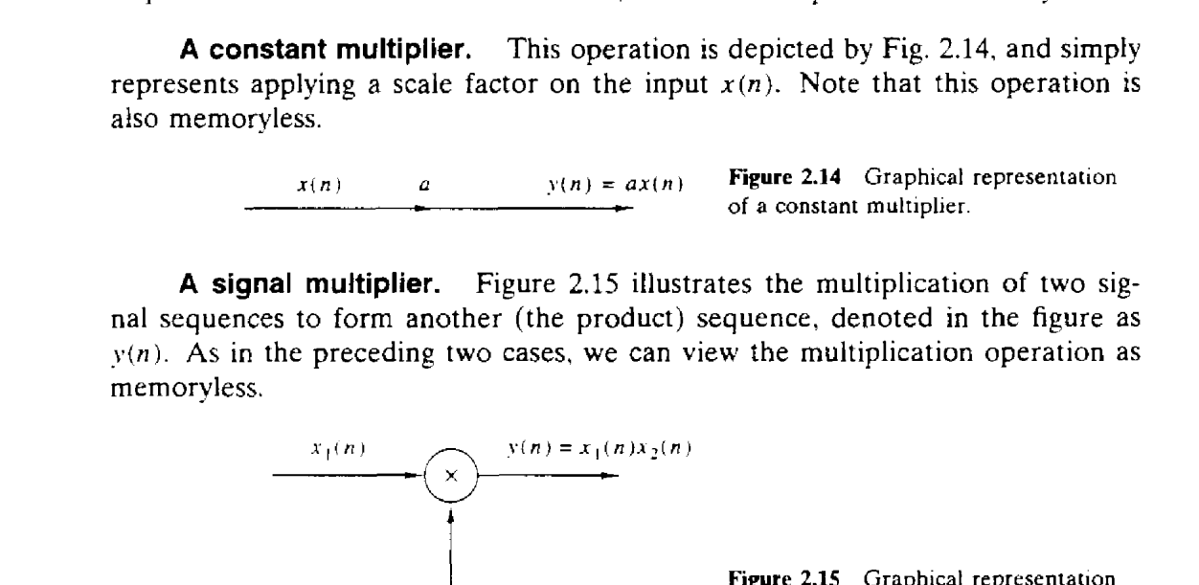

Slide 19
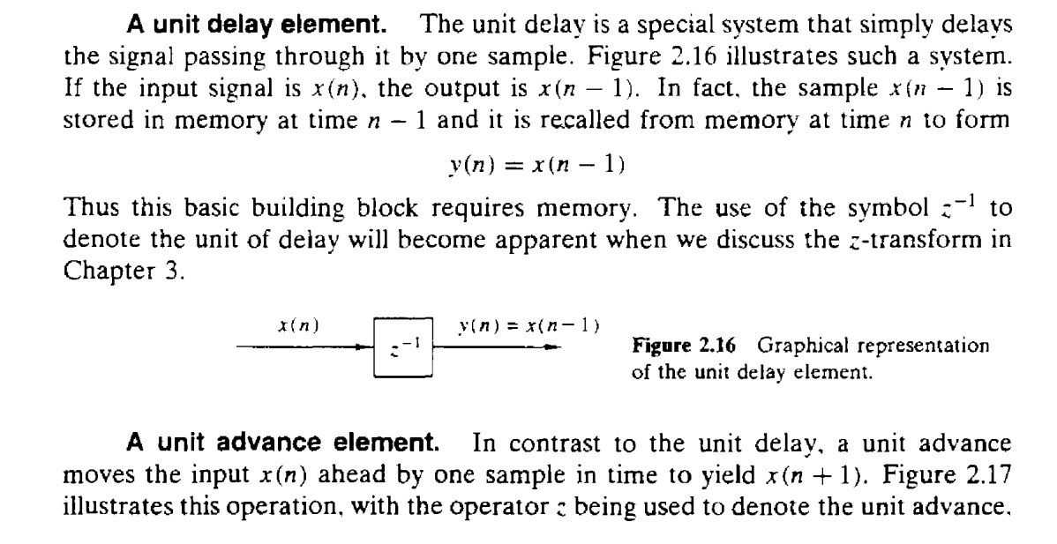

Slide 20
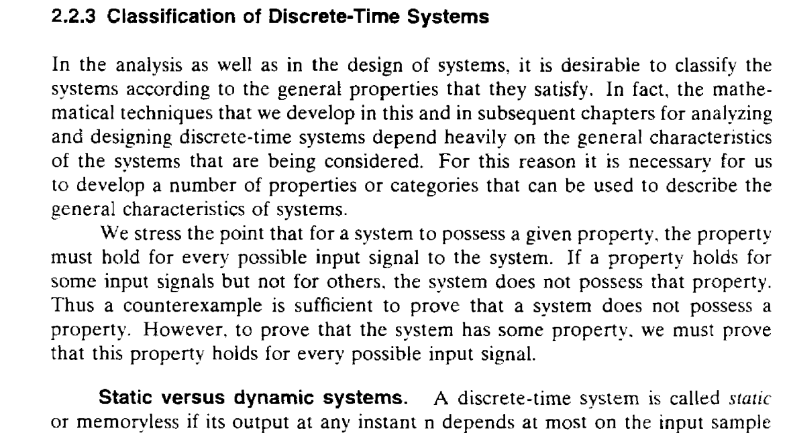

Slide 21
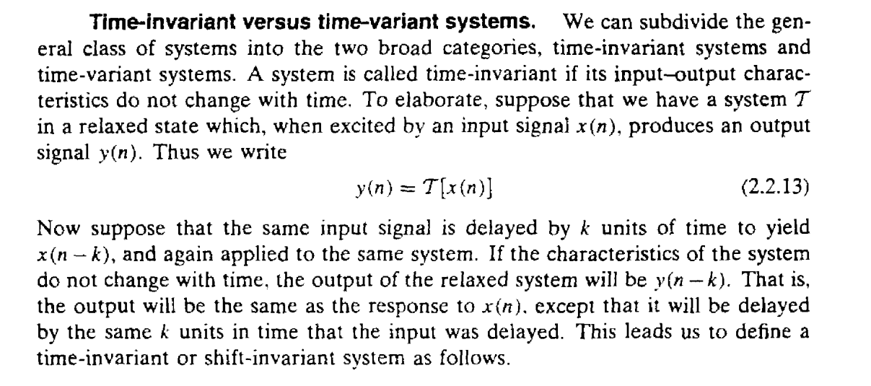

Slide 22
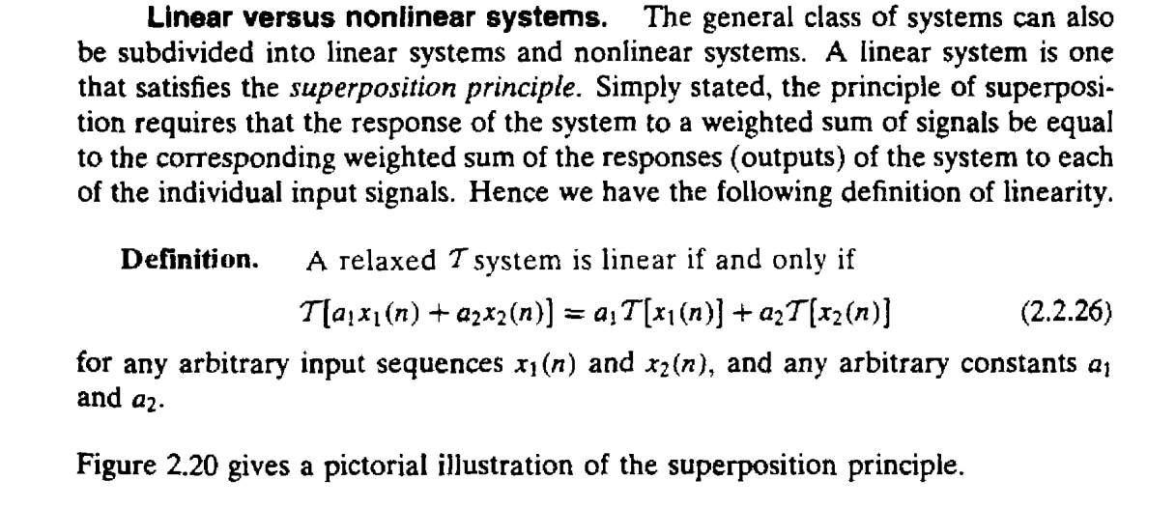

Slide 23
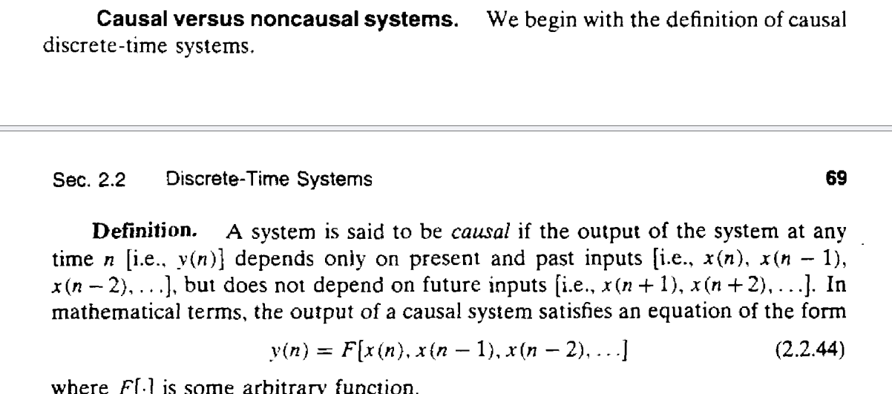

Slide 24
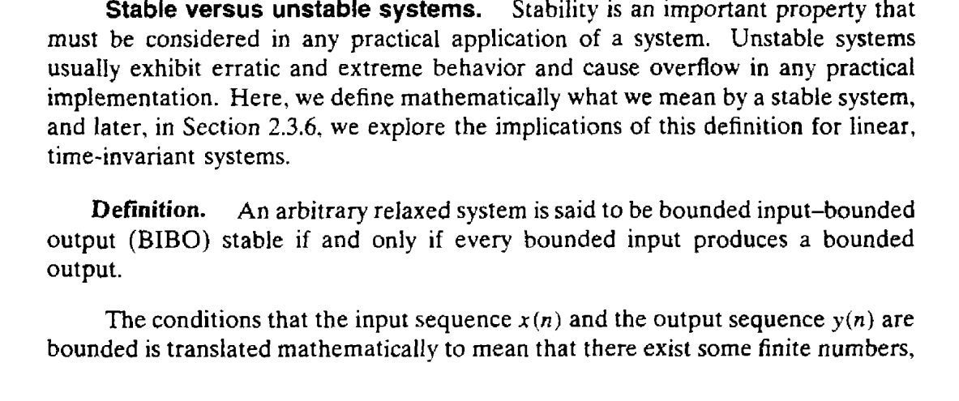

Slide 25
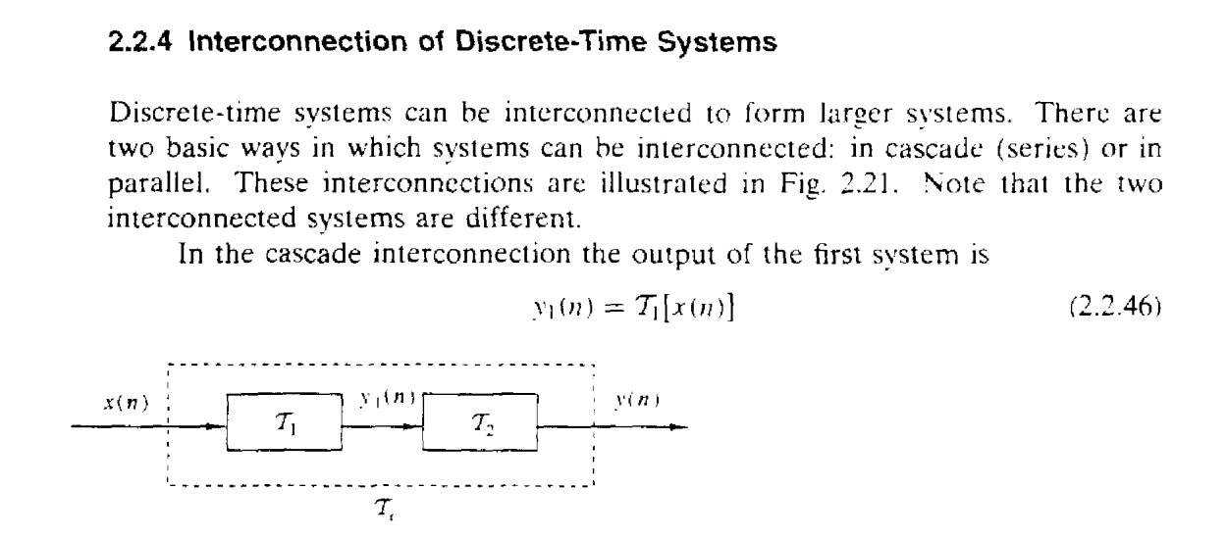

Slide 26
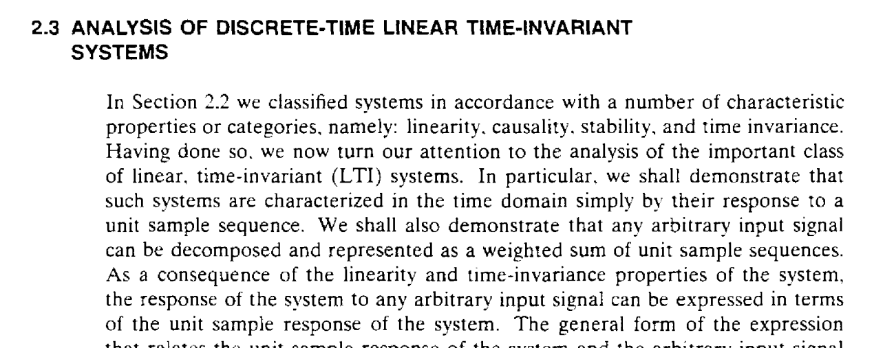

Slide 27
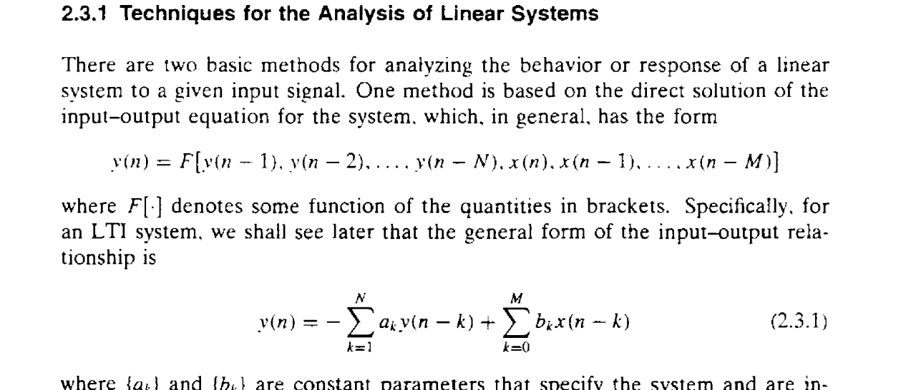

Slide 28
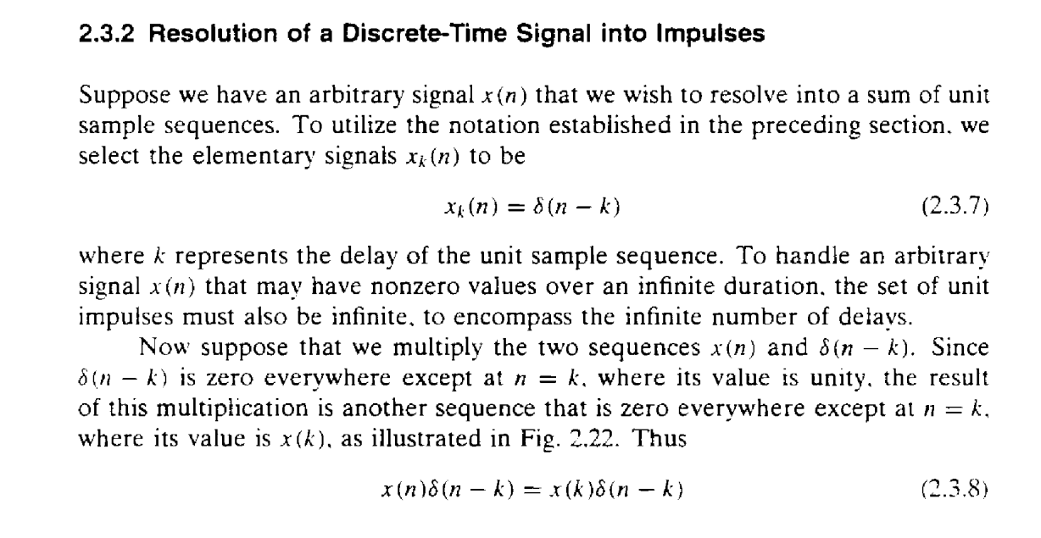

Slide 29
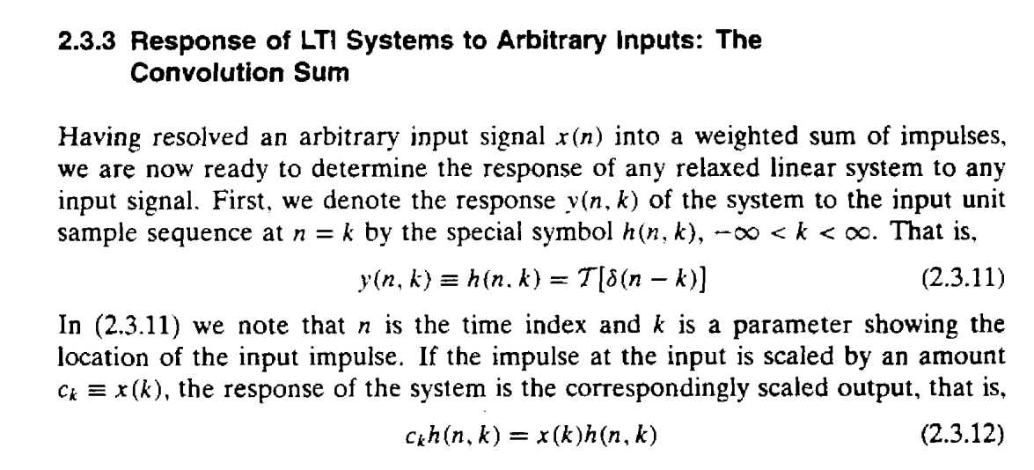

Slide 30
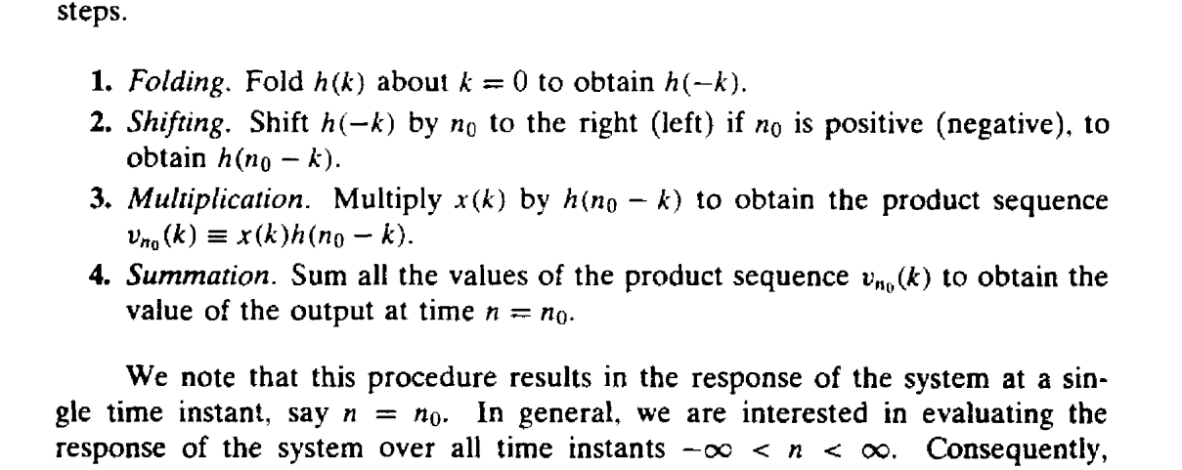

Slide 31
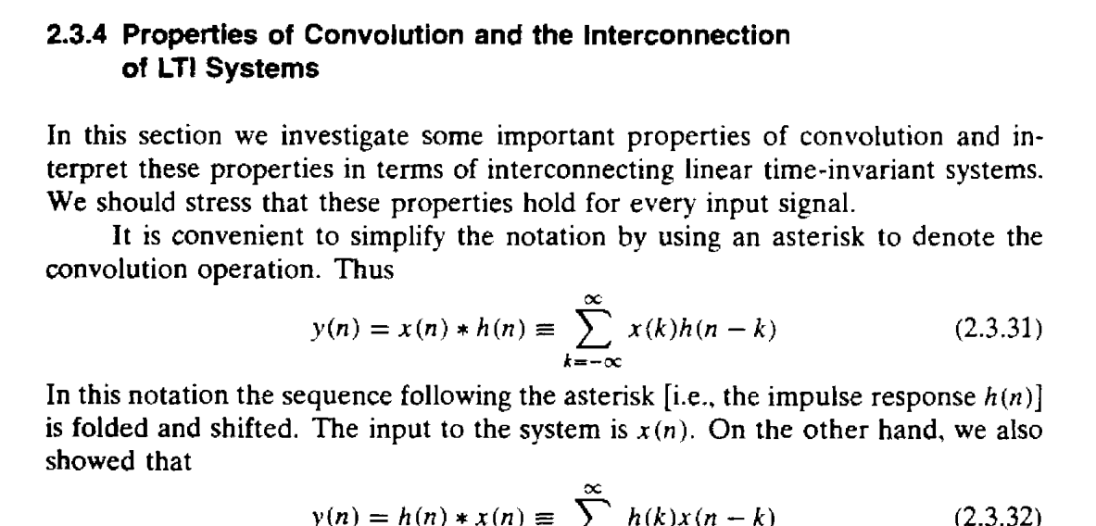

Slide 32
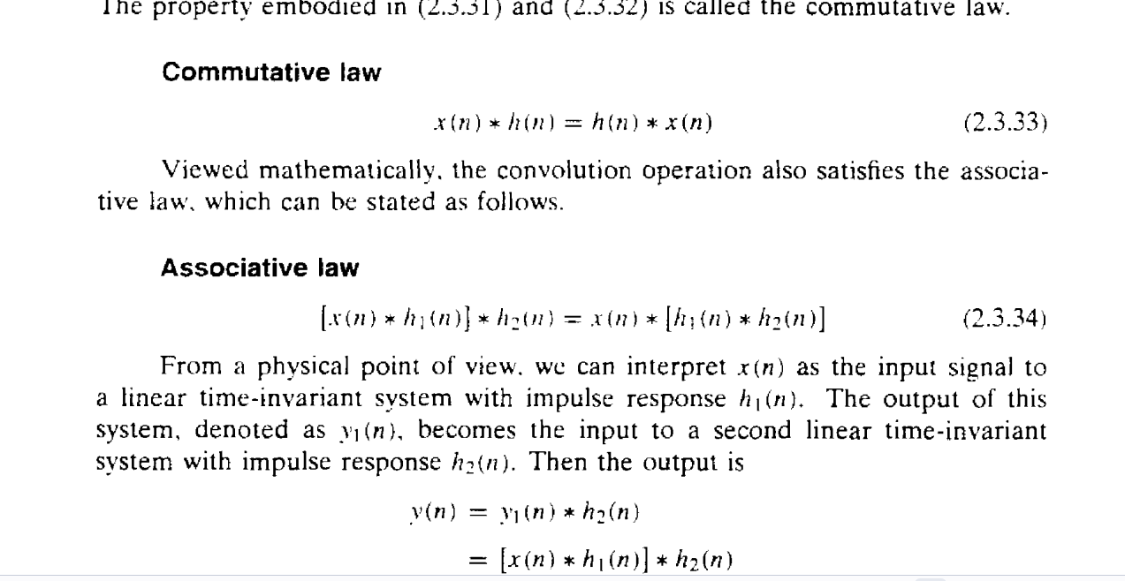

Slide 33
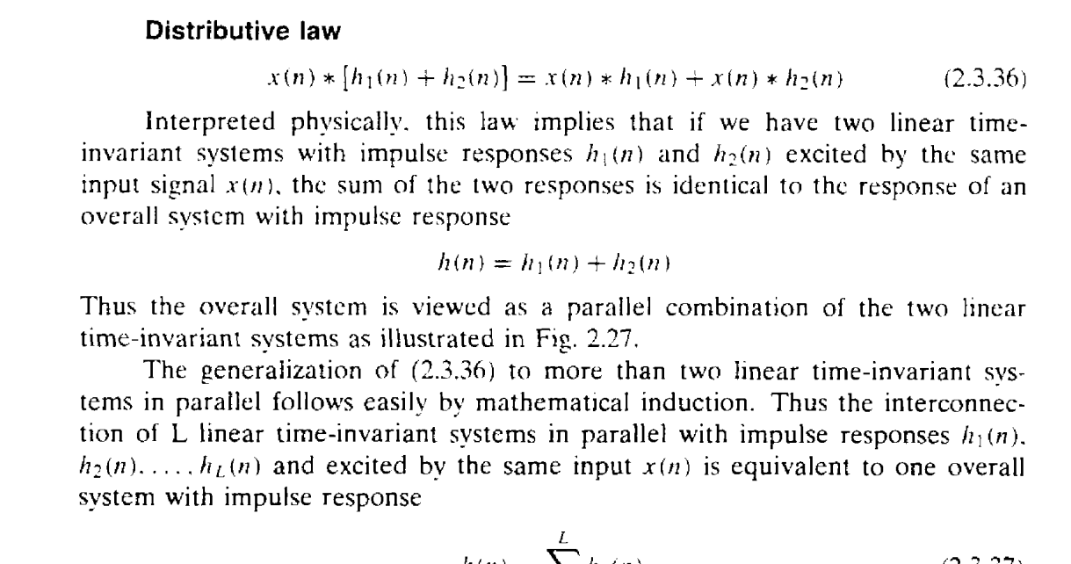

Slide 34
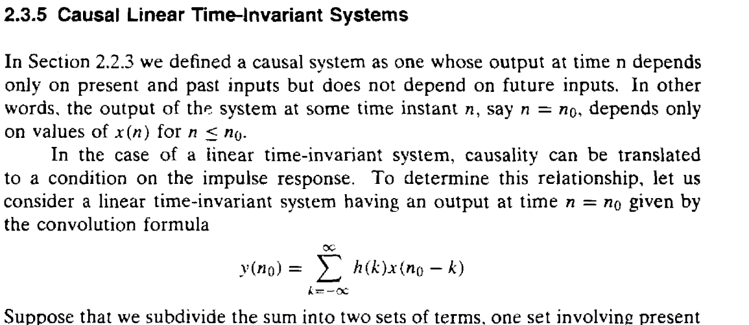

Slide 35
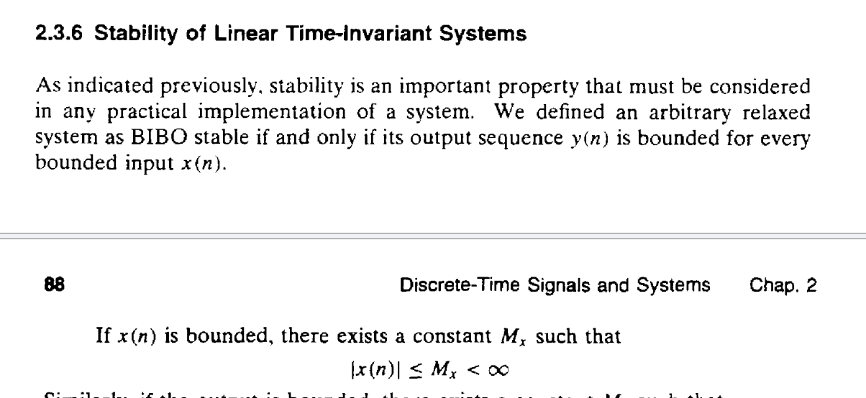

Slide 36
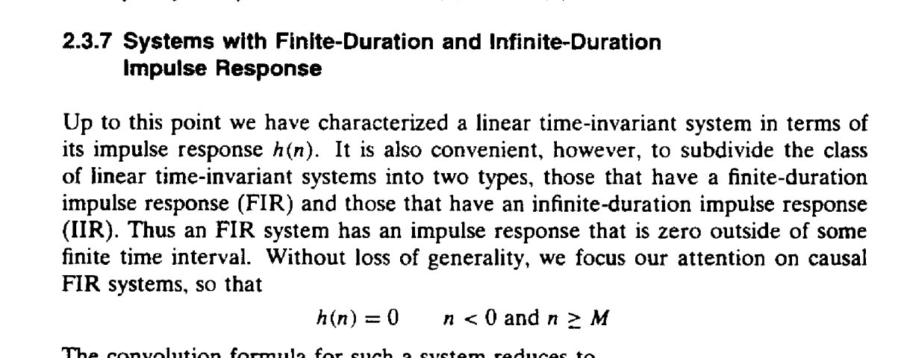

Slide 37
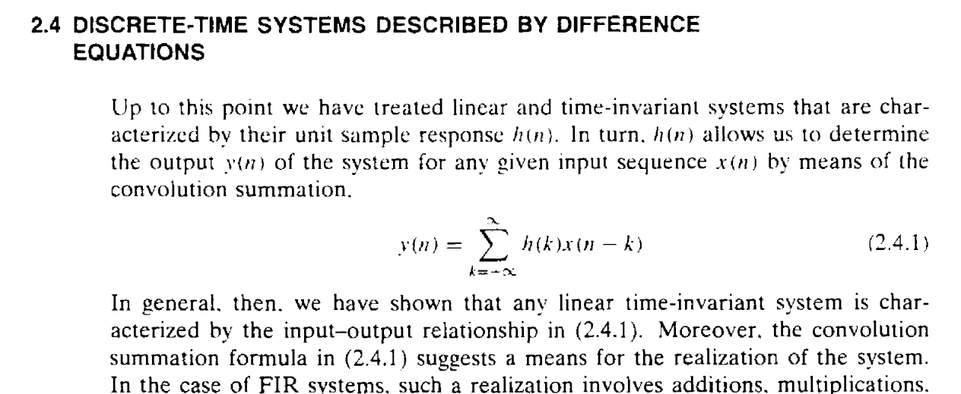

Slide 38
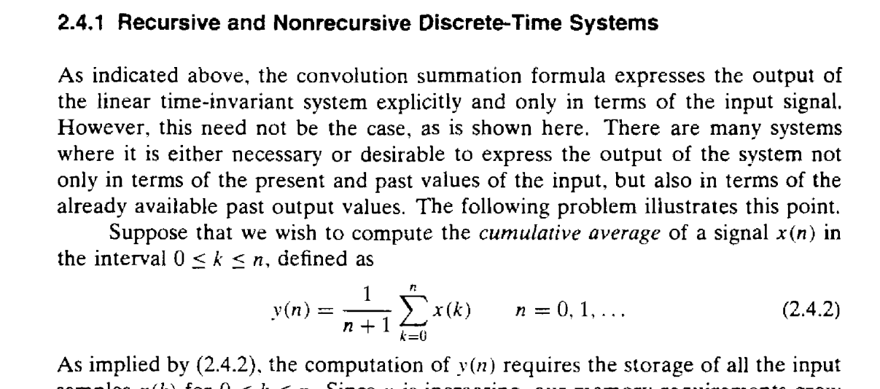

Slide 39
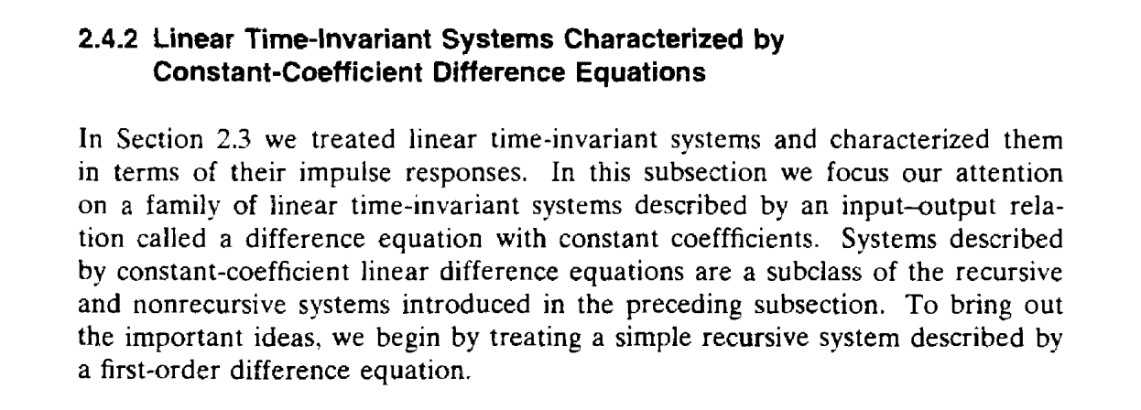

Slide 40
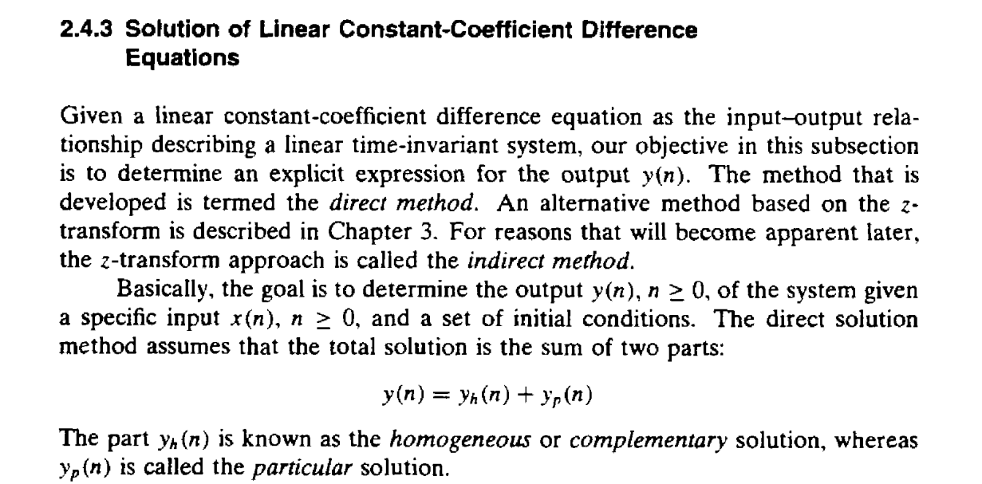

Slide 41
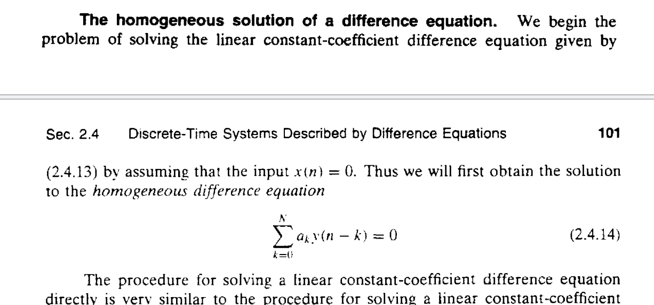

Slide 42
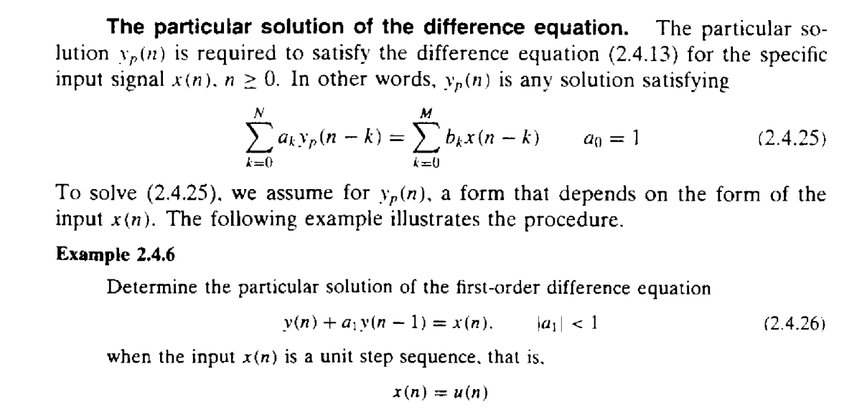

Slide 43
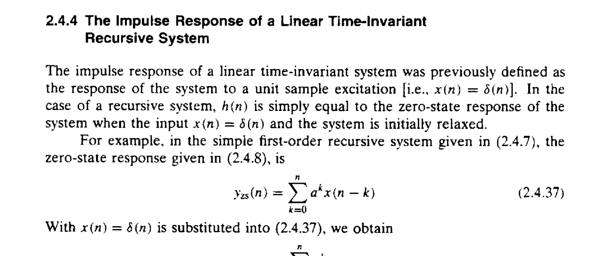

Slide 44
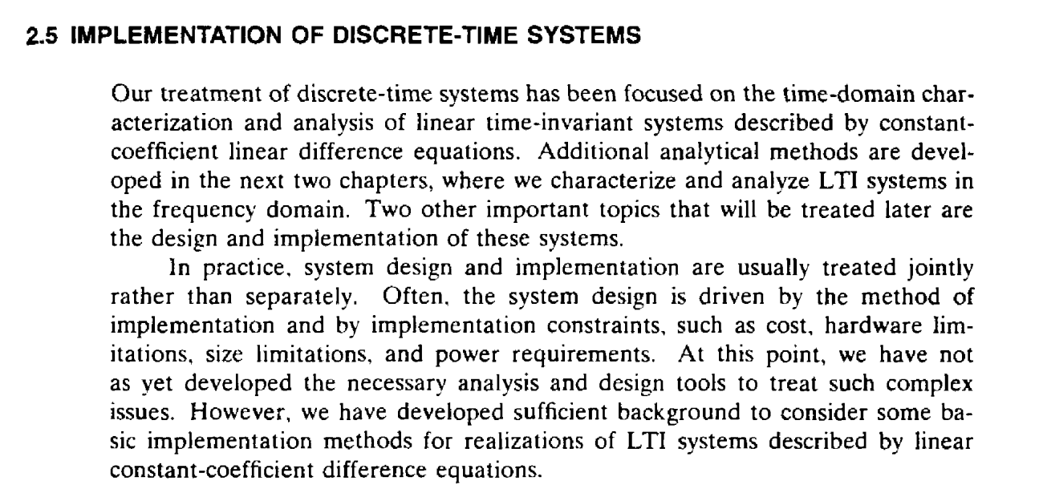

Slide 45


Slide 46


Slide 47


Slide 48


Slide 49


Slide 50


Slide 51


Slide 52


